Slide 1
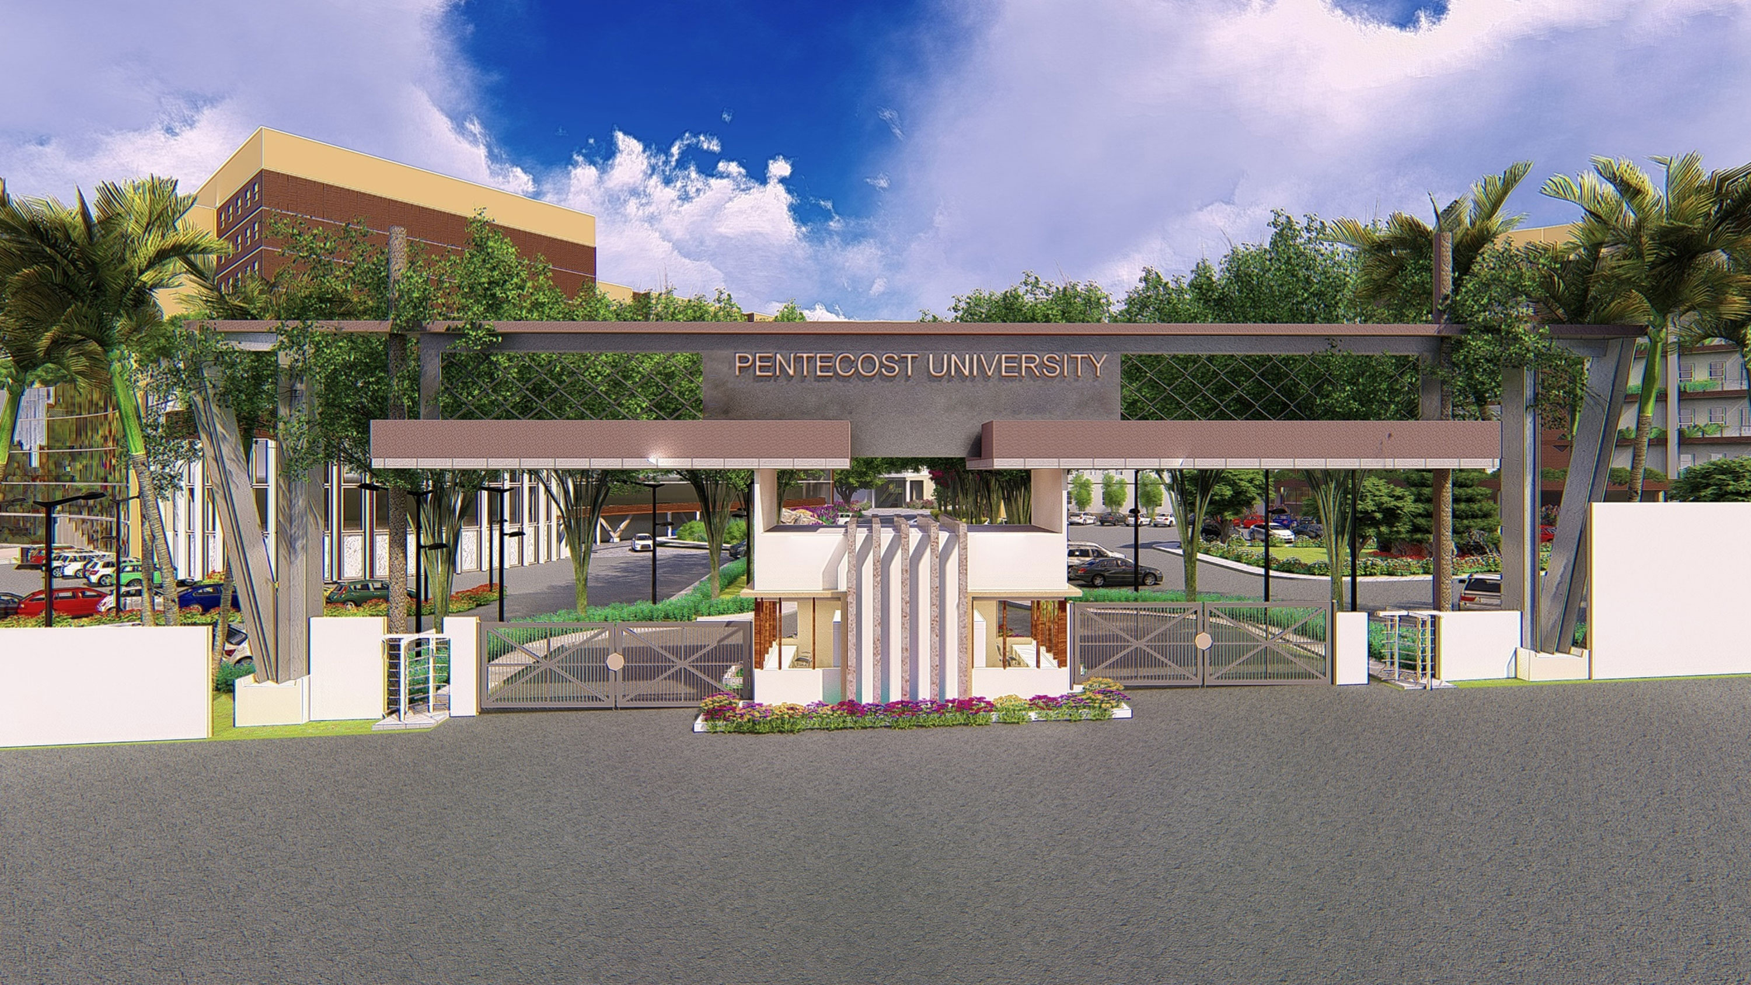

Road Accident Severity Prediction
Group 6 - Machine Learning Capstone Project

Slide 2
Presentation Outline
Introduction
Problem Statement
Overview
Dataset information
Required Python libraries
Set up and installation
Data mining methodology
Hardware requirements
Relevance of project
Conclusion and future works

Slide 3
Introduction
Road accidents are a leading cause of death worldwide. Predicting accident severity helps in proactive safety measures. Machine learning models can estimate severity based on environmental and human factors.

Slide 4
Problem Statement
• Road safety remains a global challenge.
• Need to predict severity of road accidents using available data.
• Helps prioritize emergency response and inform safety policies.

Slide 5
Overview
• Data Collection and Preprocessing
• Exploratory Data Analysis (EDA)
• Feature Selection
• Model Building and Evaluation
• Prediction and Insights

Slide 6
Dataset
• Source: Ghana Department for Transport / Kaggle datasets
• Key Attributes:
- Weather, Road Surface, Light Conditions
- Vehicle Type, Speed Limit, Casualties
• Target Variable: Severity (Slight, Serious, Fatal)

Slide 7
Required Python Libraries
• pandas, numpy, matplotlib, seaborn
• scikit-learn, xgboost, imbalanced-learn
• shap (for interpretability)

Slide 8
Setup and Installation
1. Install Python 3.8 or higher
2. Install libraries using pip:
pip install pandas numpy matplotlib seaborn scikit-learn xgboost
3. Set up Jupyter Notebook or VS Code
4. Load dataset and start analysis

Slide 9
Data Mining Methodology
CRISP-DM Framework:
1. Business Understanding
2. Data Understanding
3. Data Preparation
4. Modeling
5. Evaluation
6. Deployment

Slide 10
Hardware Requirements
• Processor: Intel i5 or higher
• RAM: 8GB minimum (16GB recommended)
• Storage: 10GB free space
• GPU: Optional for deep learning
• OS: Windows, macOS, or Linux

Slide 11
Relevance of the Project
• Enhances Public Safety and Emergency Response
• Supports Urban Planning and Policy Making
• Helps Insurance Companies in Risk Assessment
• Promotes Data-Driven Decision Making

Slide 12
Conclusion & Future Work
• ML models can predict road accident severity effectively.
• Important factors: weather, road surface, light conditions.
Future Work:
• Integrate real-time data and geospatial analysis.
• Use deep learning for improved prediction.
• Develop web/mobile applications for real-time prediction.

Slide 13
THANK YOU

Slide 14


1. Problem Solving PU Academics

